Slide 1

MOOCs – The Future Is Getting Clearer
Charles Severance
International NCSC ONE Conference 2015
14-April-2015
Notes:
Total students: 363K, paid 3325 1/10 finished 1/100 paid 150K students 1486 books wholesale for my book $3.82

Slide 2
The Short Version of This Talk
Universities around the world are very busy using various types of involvement in the MOOC movement as a way to reimagine how teaching is done and what it means to teach.
The results for most organizations so far are nearly all positive.
Notes:
It is not about transforming education – but it will transform education. Negative consequences are limited to the weak and marginal.

Slide 3
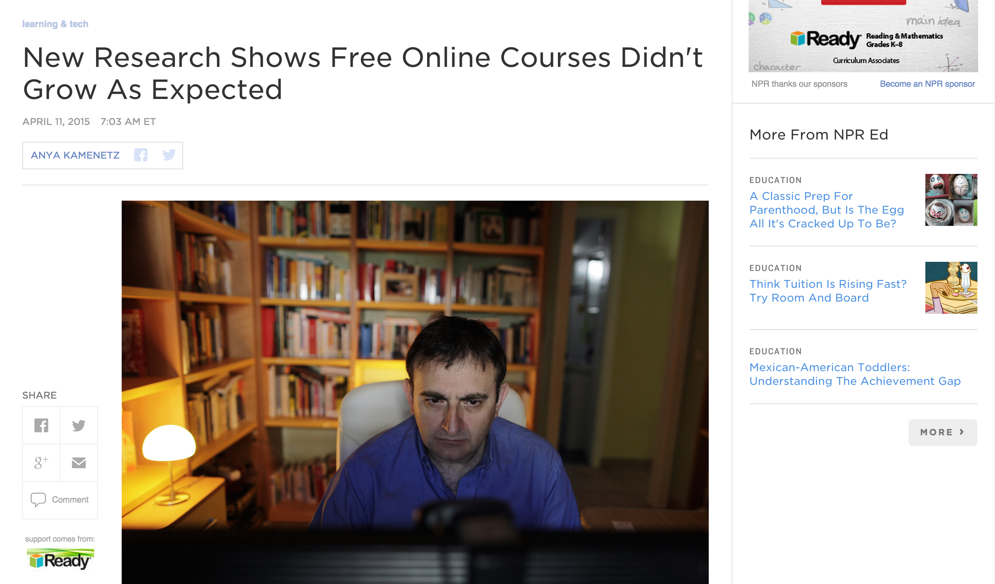
http://www.npr.org/blogs/ed/2015/04/11/397295495/the-future-of-free-online-courses-new-research-from-mit-and-harvard
Notes:
People who are not really involved have a lot of time on their hands. Those of us doing this work are super busy and having lots of fun.

Slide 4
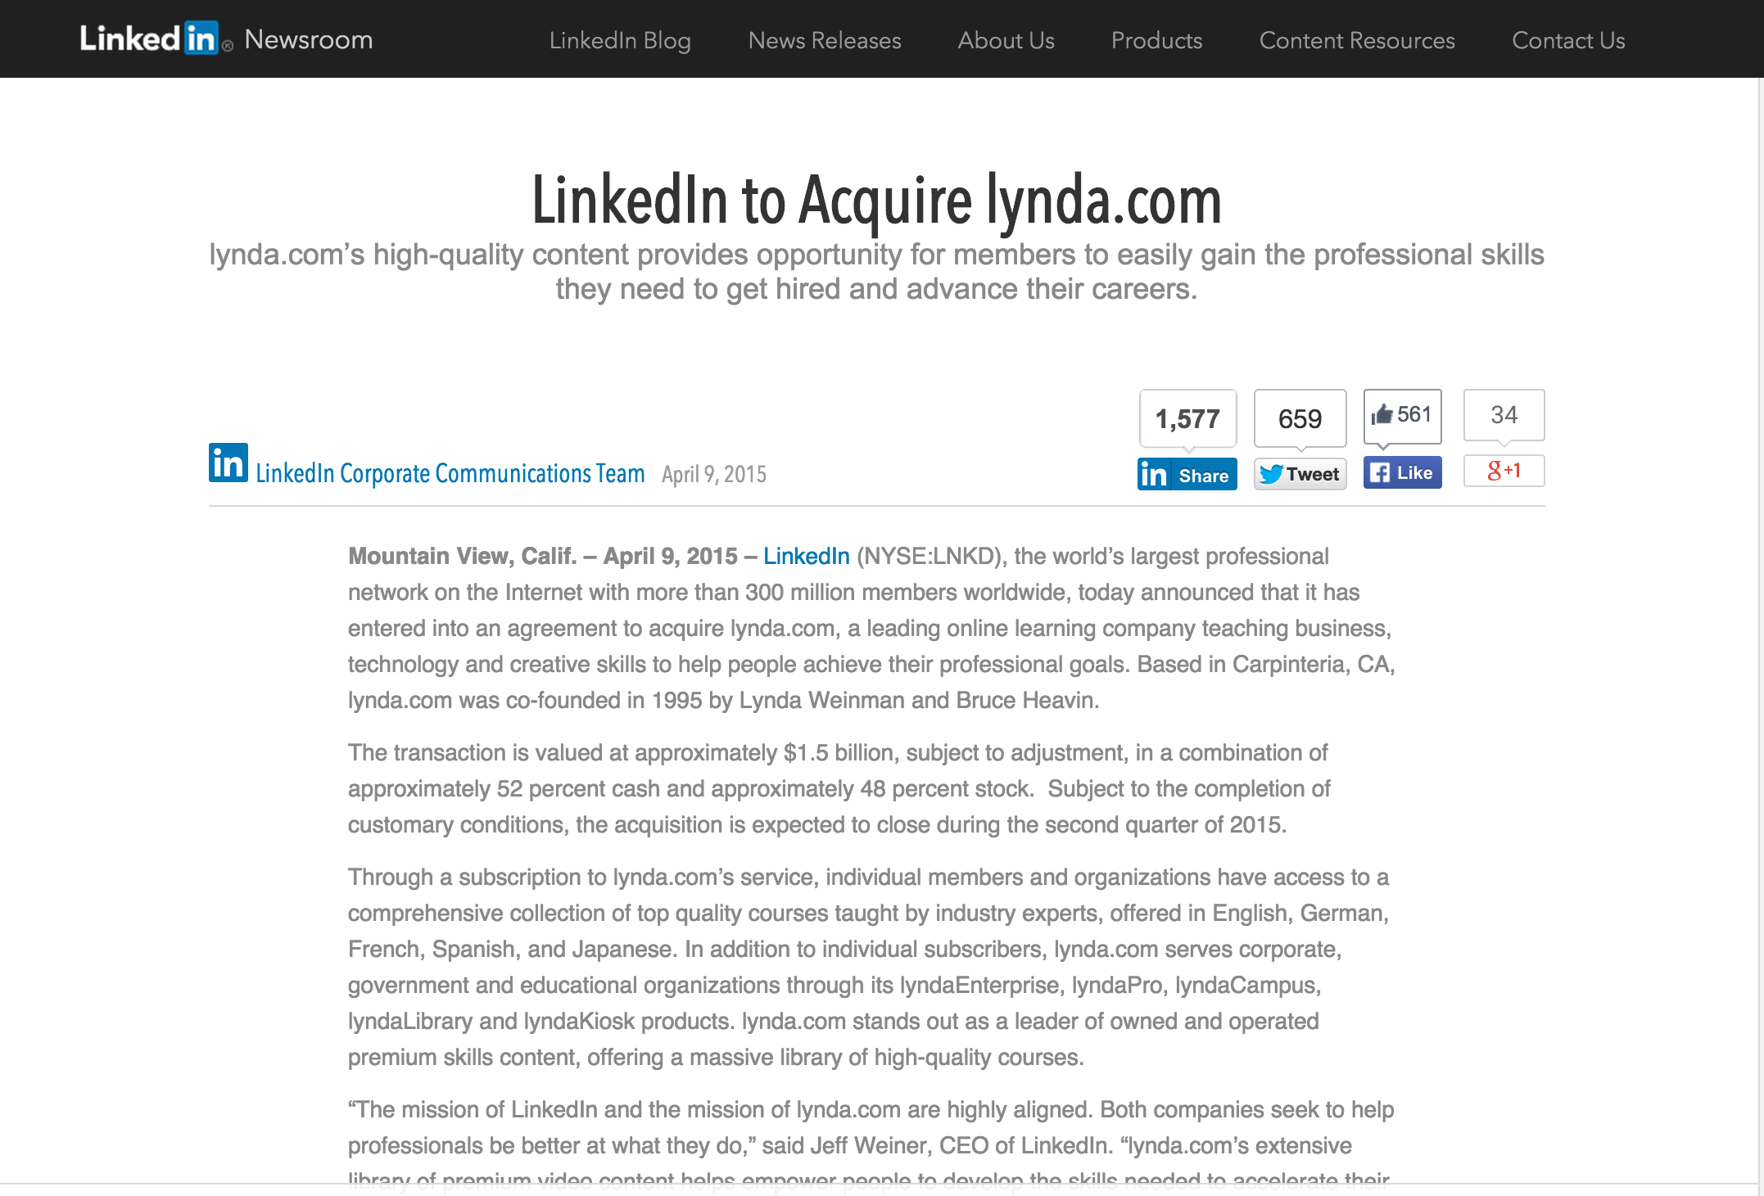
https://press.linkedin.com/site-resources/news-releases/2015/linkedin-to-acquire-lyndacom

Slide 5
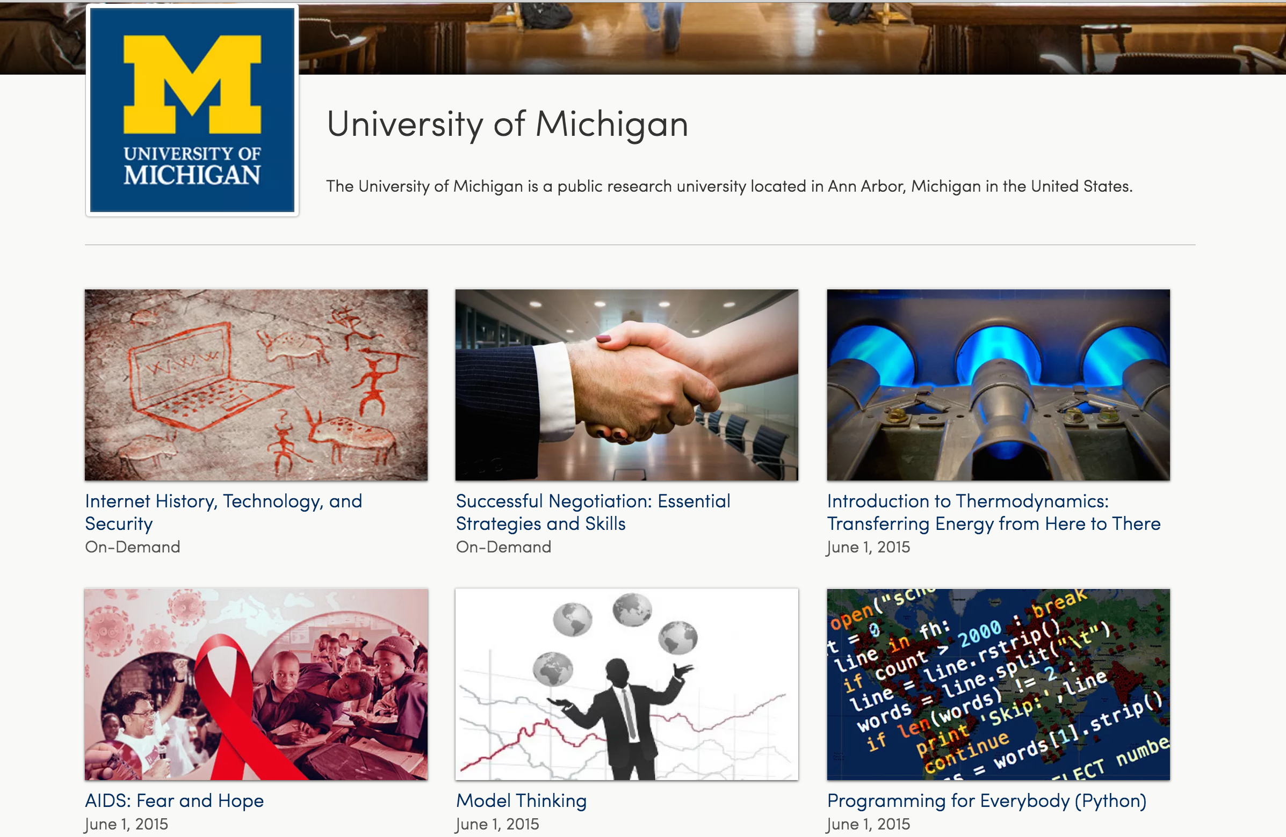
Notes:
It is a responsibility of a public university to lead and define this new space MOOC "Semesters" First week of February, June, and October 30+ courses per year 15 Support Staff Galvanizing education research on campus Learning Analytics Pedagogy

Slide 6
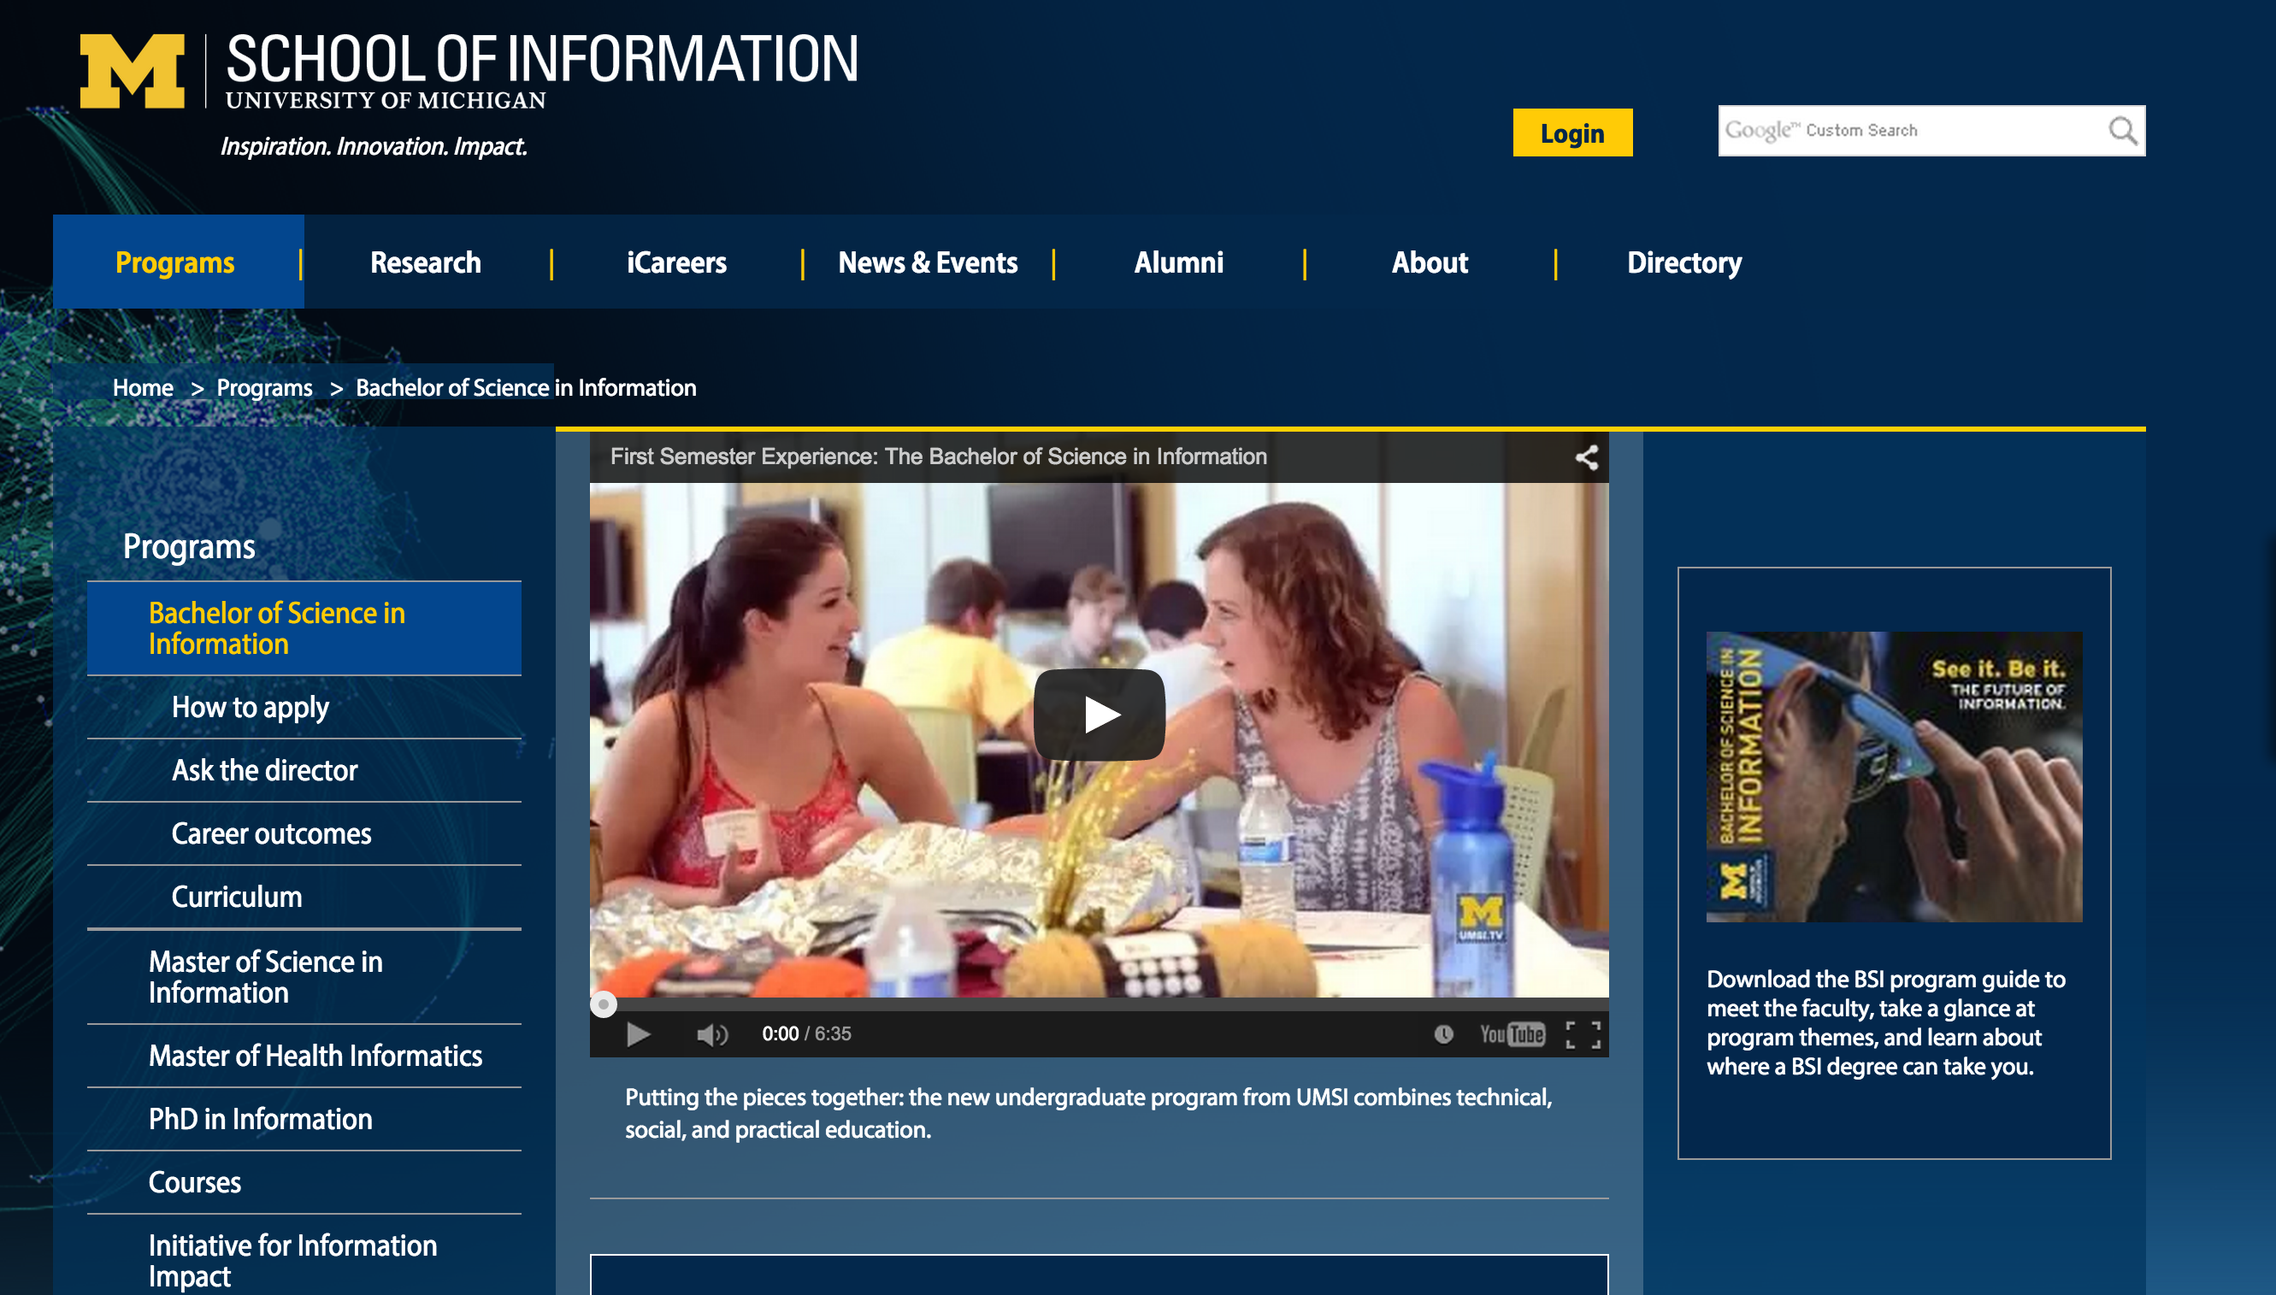
Python, R, JavaScript, Java, PHP, SQL, Swift, ObjectiveC. Statistics, Visualization, Economics, Game Theory, Motivation, Network Analysis, Data Mining...
Notes:
Evaluation, Design and Implementing Technology systems BSI, Python, R, JavaScript, Java, PHP, SQL, Swift, ObjectiveC. Statistics, Visualization, Economics, Game Theory, Motivation, Network Analysis.

Slide 7
Python, R, JavaScript, Java, PHP, SQL, Swift. Statistics, Visualization, Economics, Game Theory, Motivation, Network Analysis, Data Mining, Design, Evaluation ...
Notes:
2015 – 57% women

Slide 8
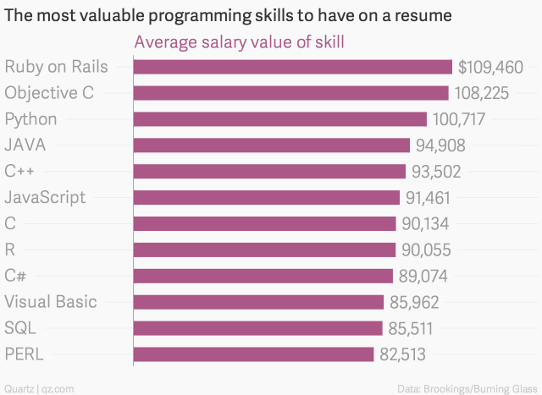
http://qz.com/298635/these-programming-languages-will-earn-you-the-most-money/

Slide 9
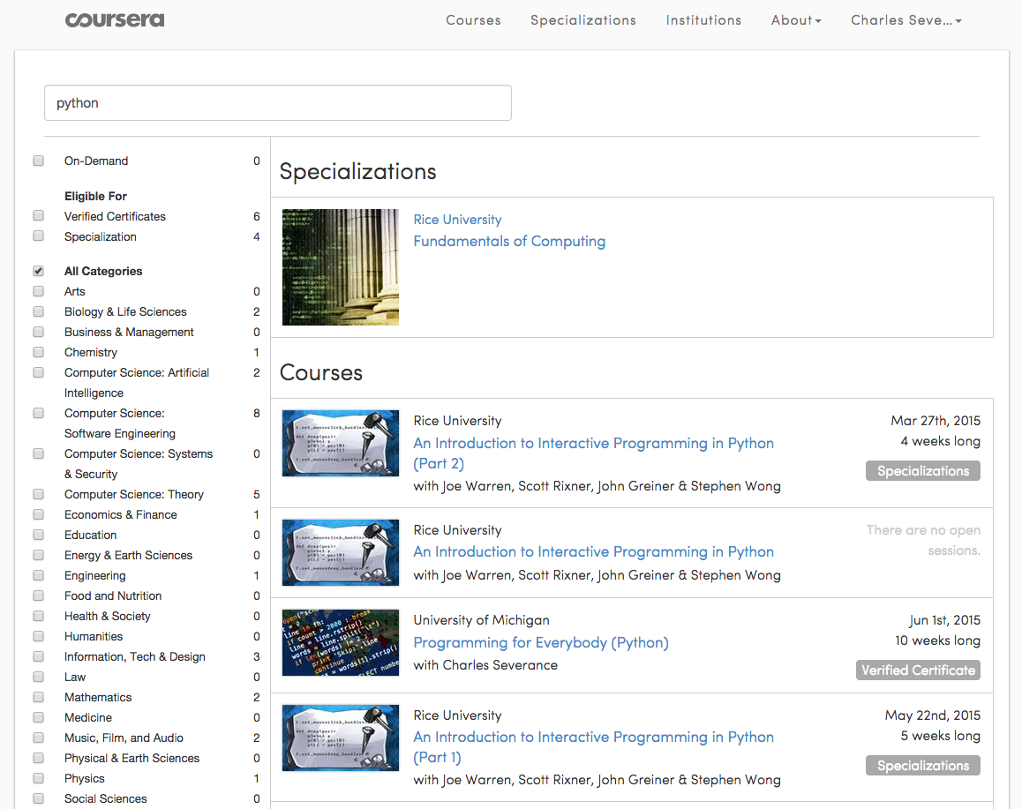
>12 Million Students

Slide 10
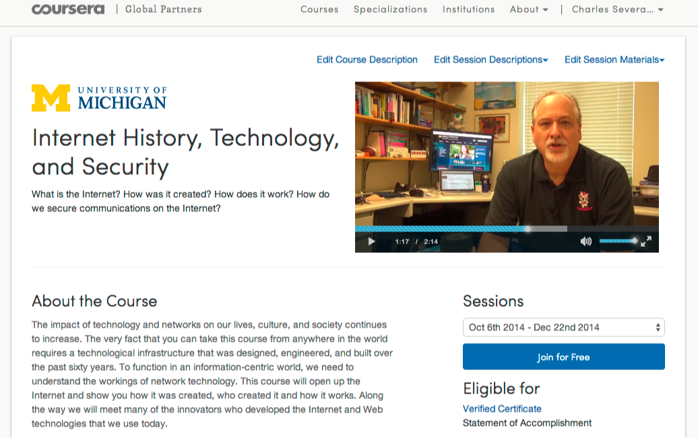

Slide 11
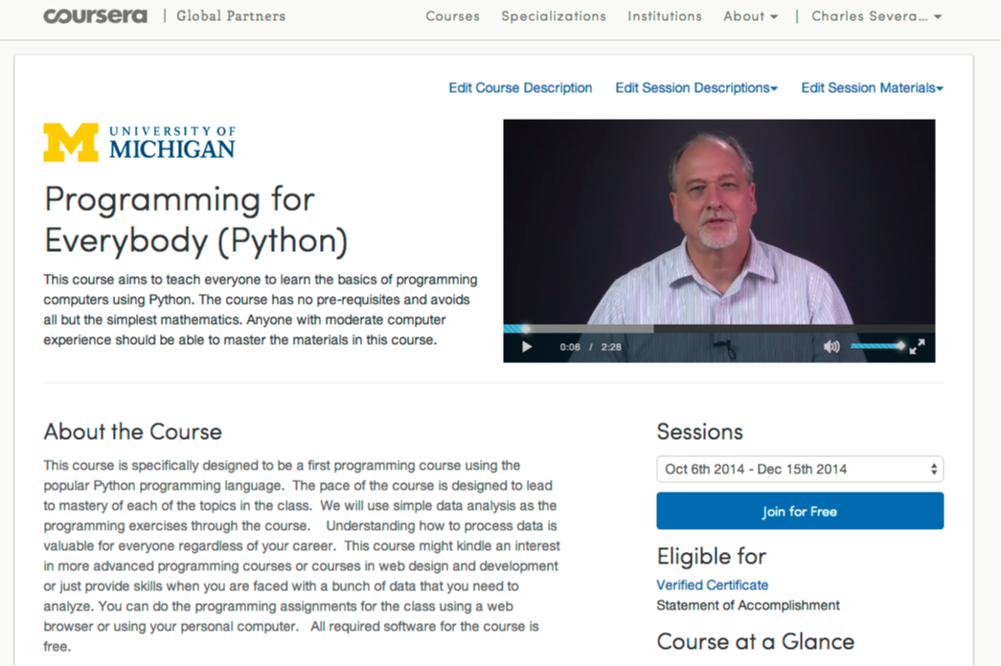

Slide 12
562,767 Total Enrollment
> 350K Revenue
27K Certs in 2014

Slide 13

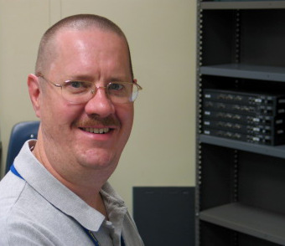
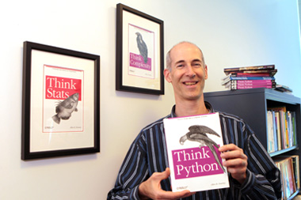
A Free Book
www.pythonlearn.com

Slide 14
New York, Los Angeles, Ann Arbor, Chicago, Washington DC, Memphis, Seattle, Seoul, Barcelona, London, Mexico City, Amsterdam, Manila Melbourne, Perth...
office-hours.dr-chuck.com
Notes:
Since I have a very active travel schedule, I decided to hold office hours in the major cities I have visited in the past 18 months. I have held office hours in over 15 cities and in each location somewhere between two and 15 students show up.

Slide 15
Open Education at scale
Notes:
What is wrong with this picture??

Slide 16
One of these things is not like the others:
www.masteringphysics.com
www.masteringastronomy.com
www.masteringpython.com

Slide 17


Slide 18
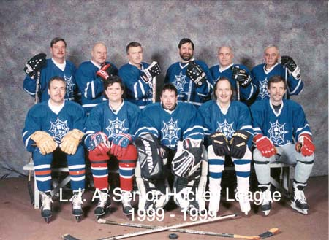
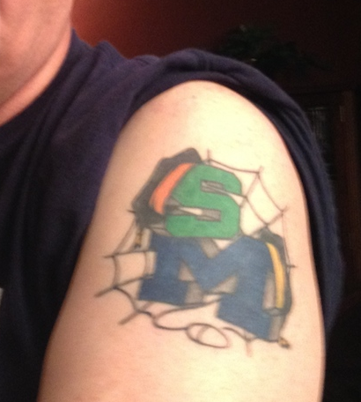

Slide 19
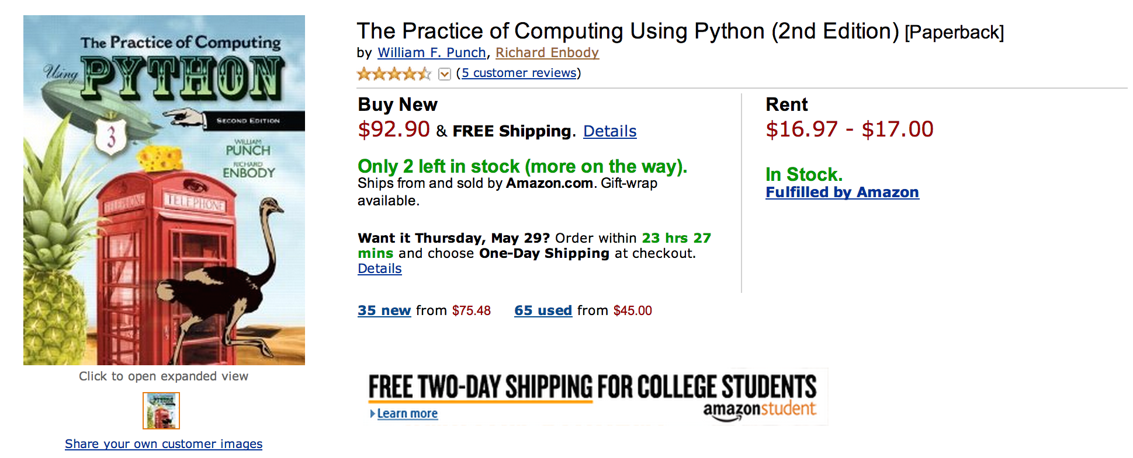
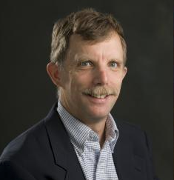
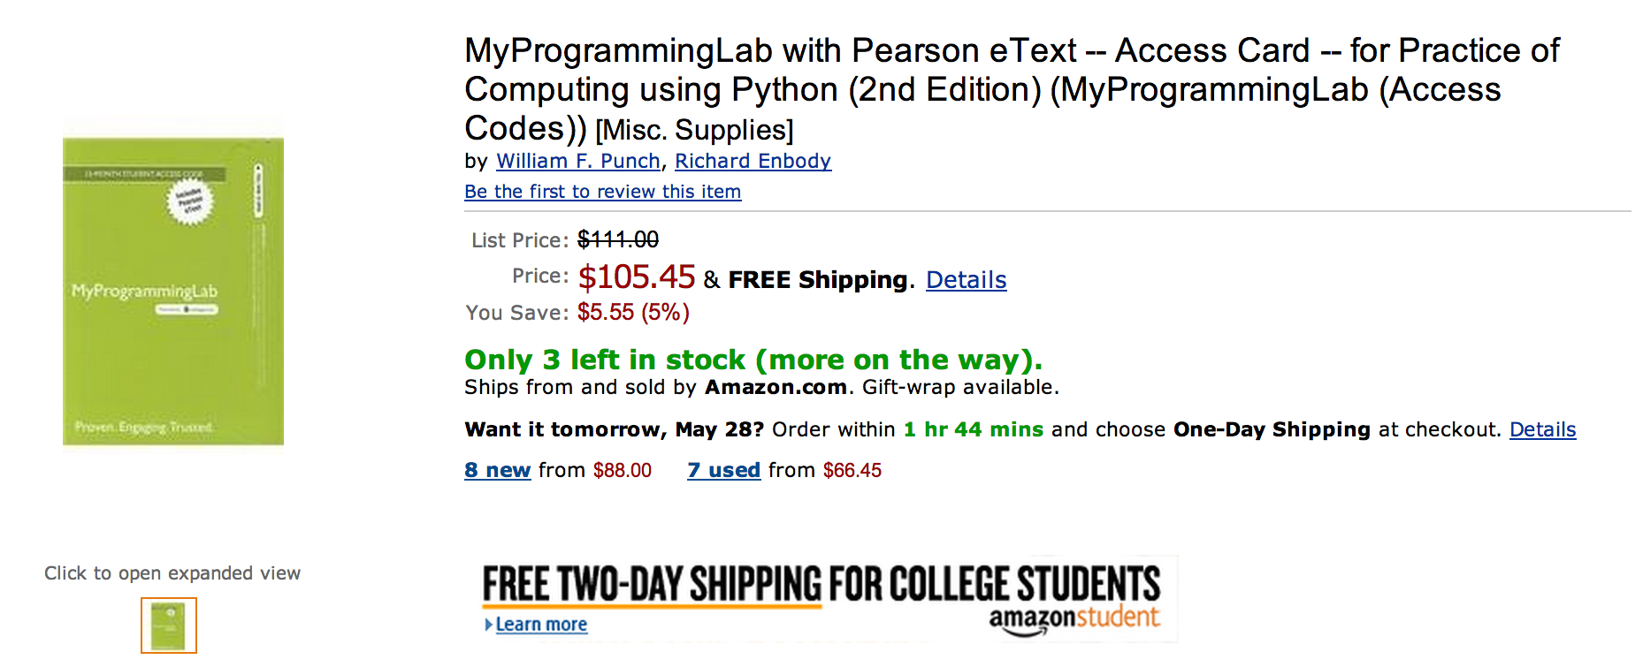

Slide 20
What does $198.35 get you?
Book
Automatic Homework Grading Software
Learning Management System Integration
Instructor Materials
Slides / Solutions Manual / Exams / Course Copy
Instructor Training
3-5 days from notification to full course
Notes:
$65 from Pearson $130 Form bookstore

Slide 21

Teacher Prep
Book
Pearson Value
Proposition
$200
Marketing
Software

Slide 22
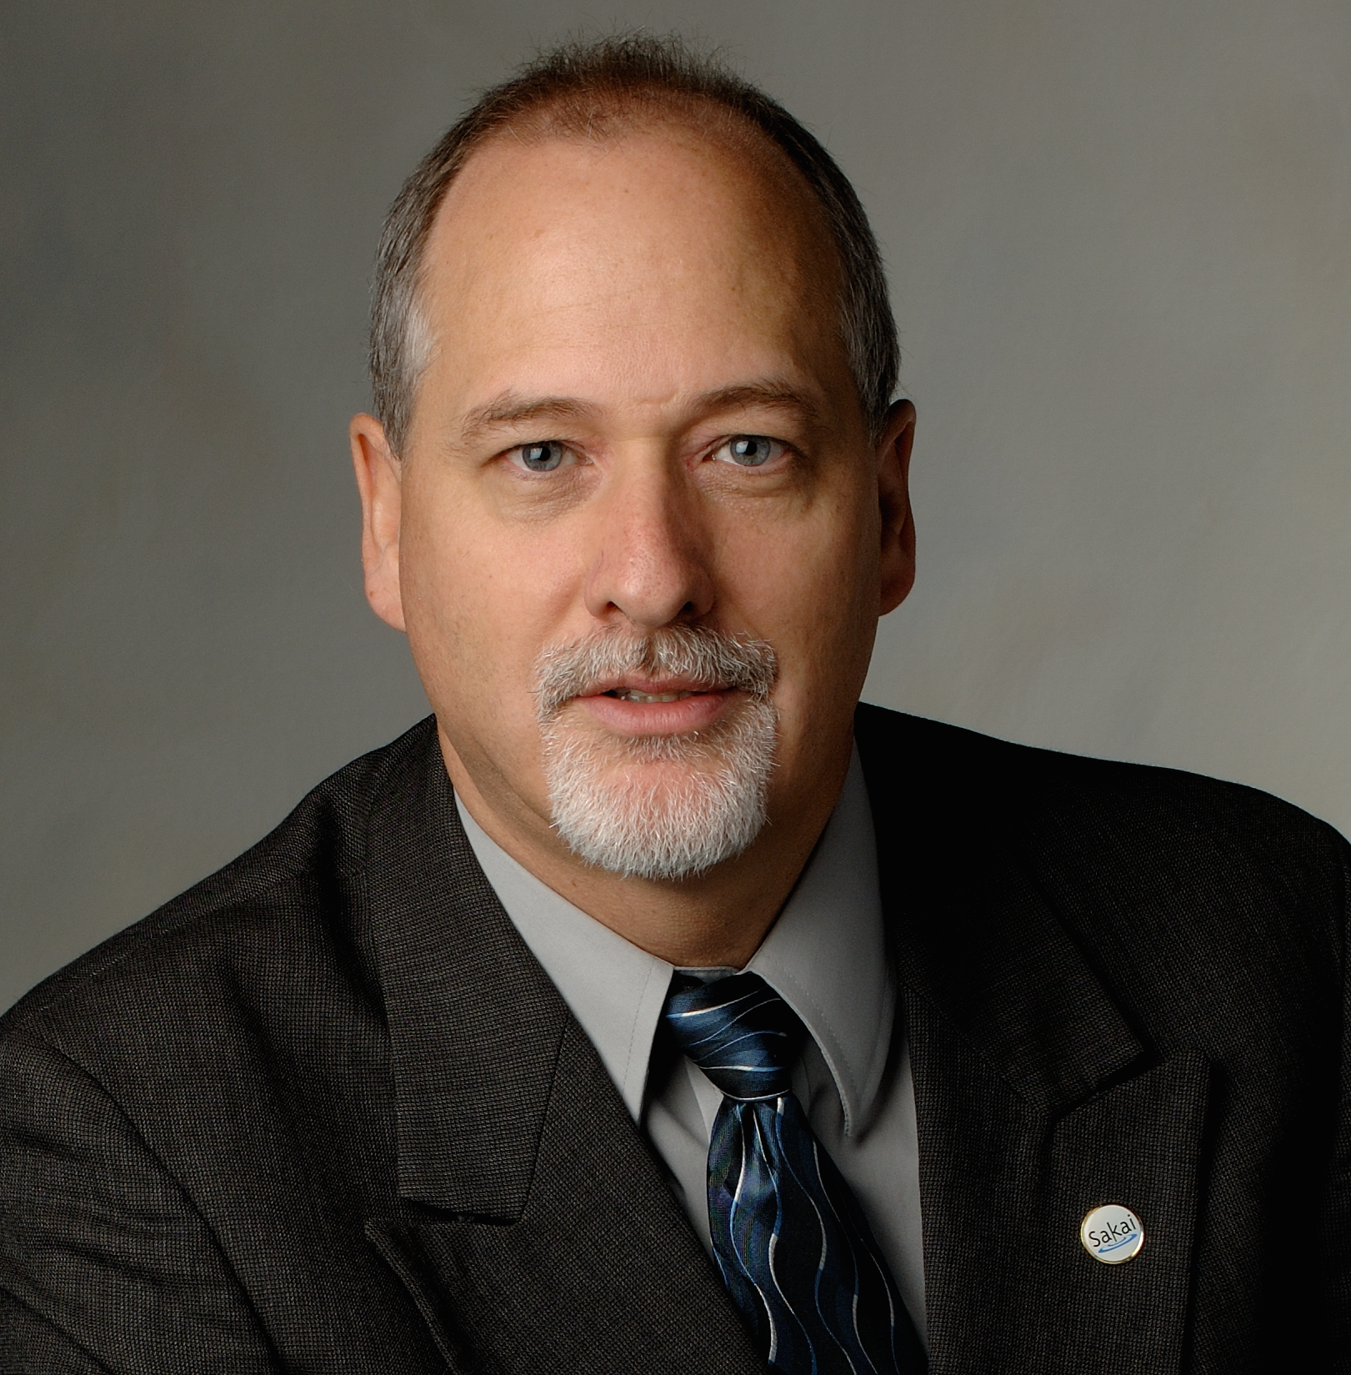
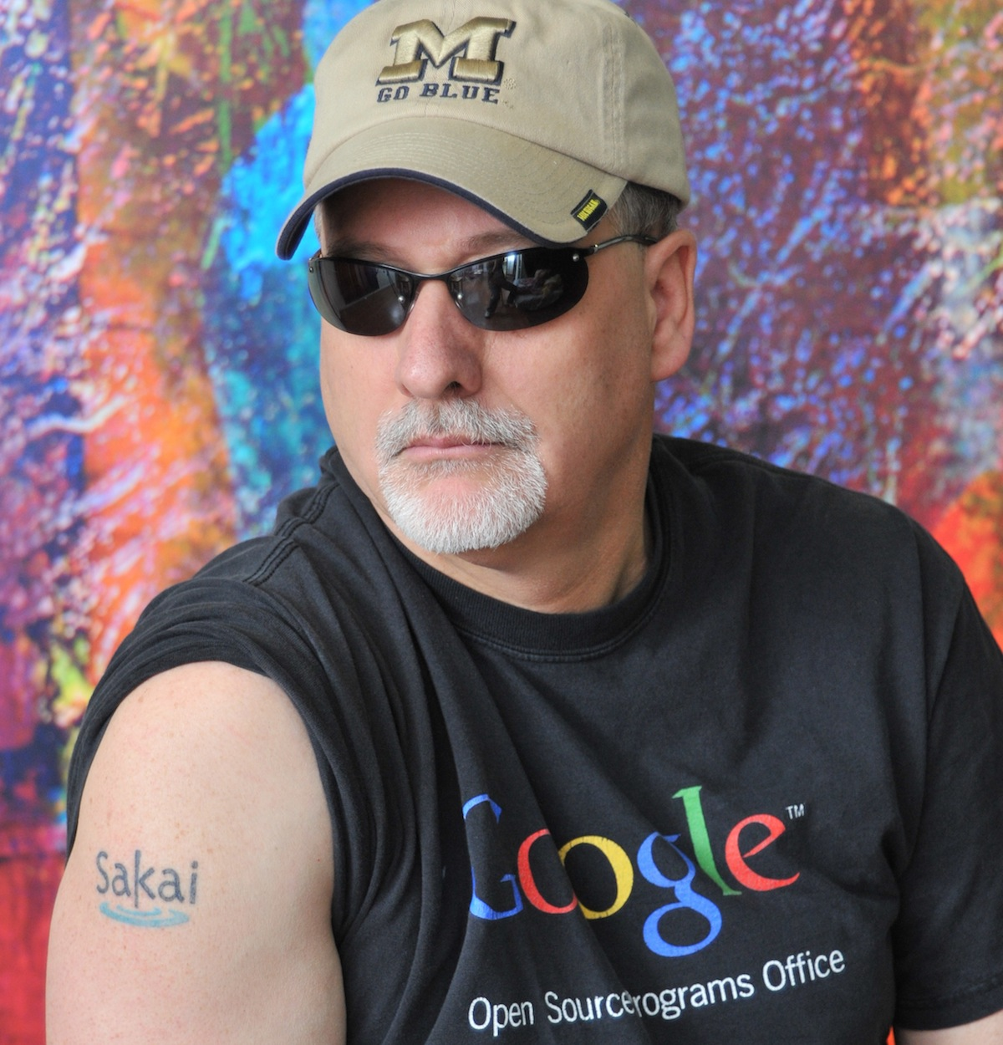



Slide 23
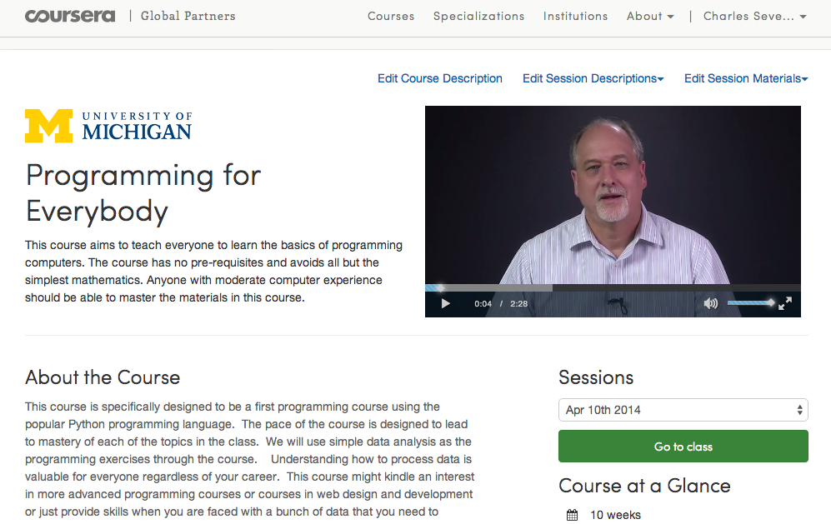

Slide 24
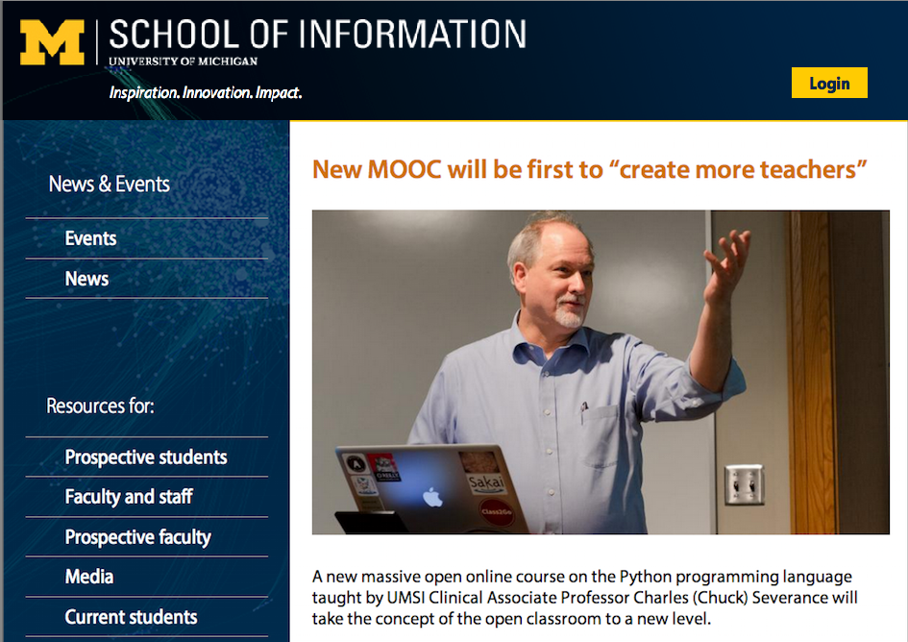

Slide 25
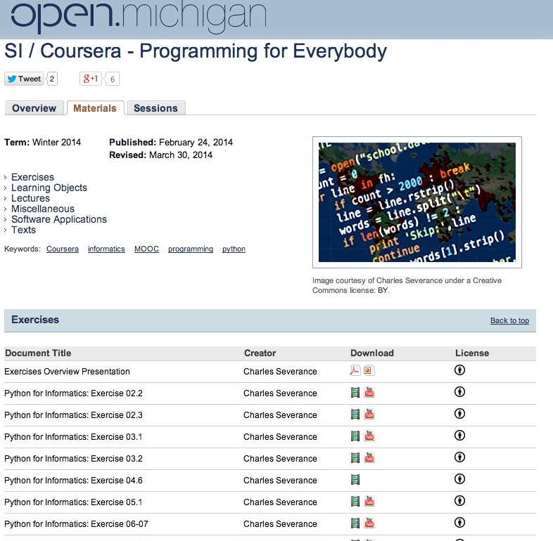

Slide 26
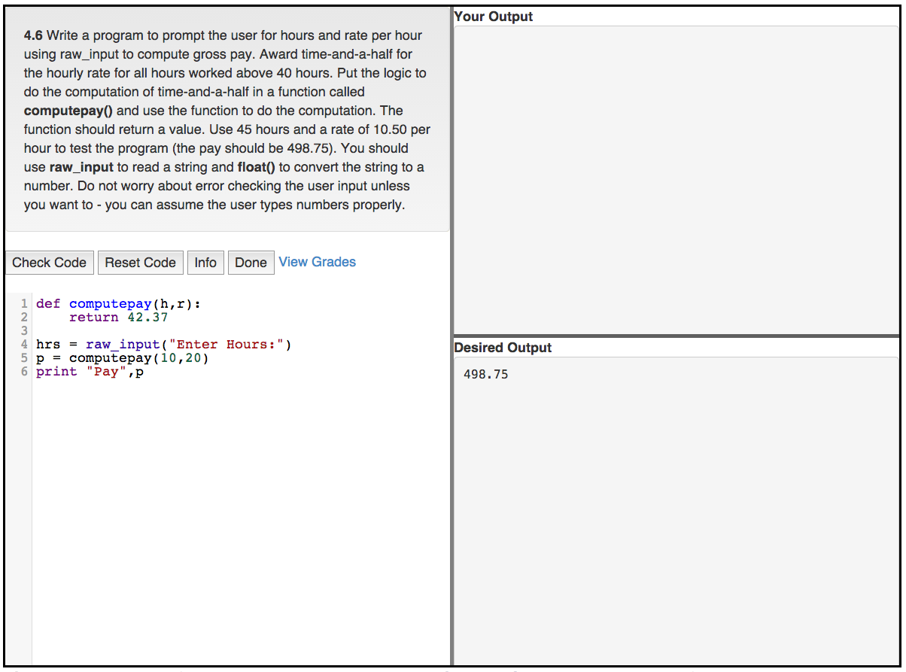
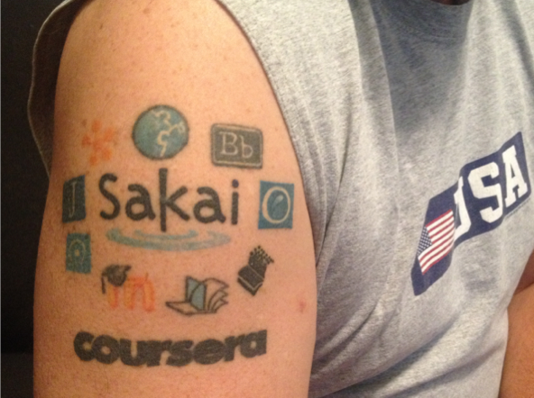

Slide 27
Teacher Prep
Book
Value
Proposition
Software
Free (or $9)
Marketing
Community
Notes:
Will I get

Slide 28
Freely licensed content...

Slide 29
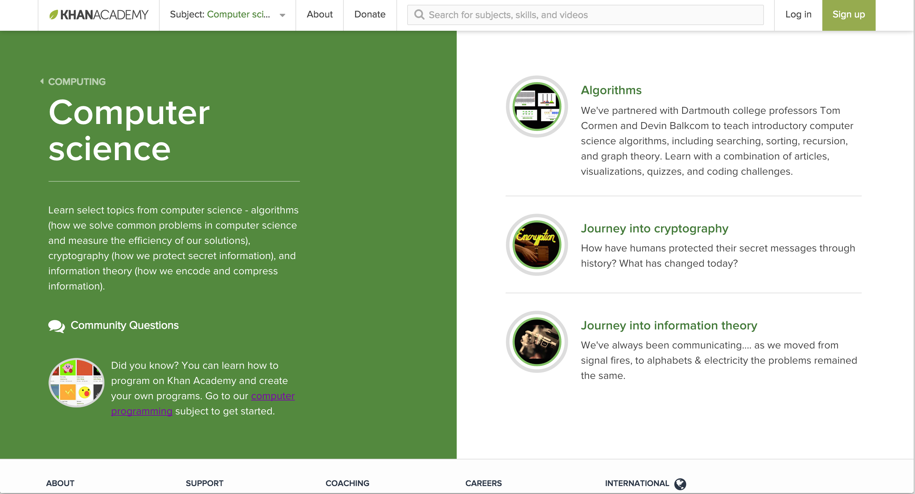

Slide 30
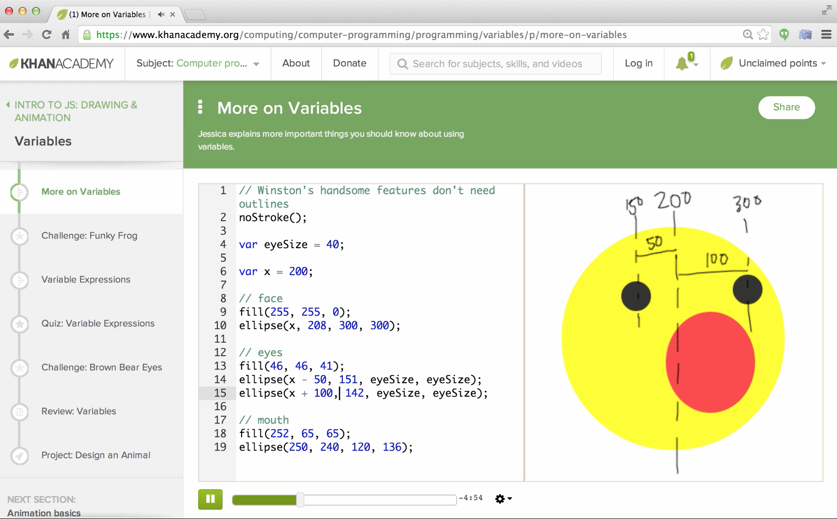
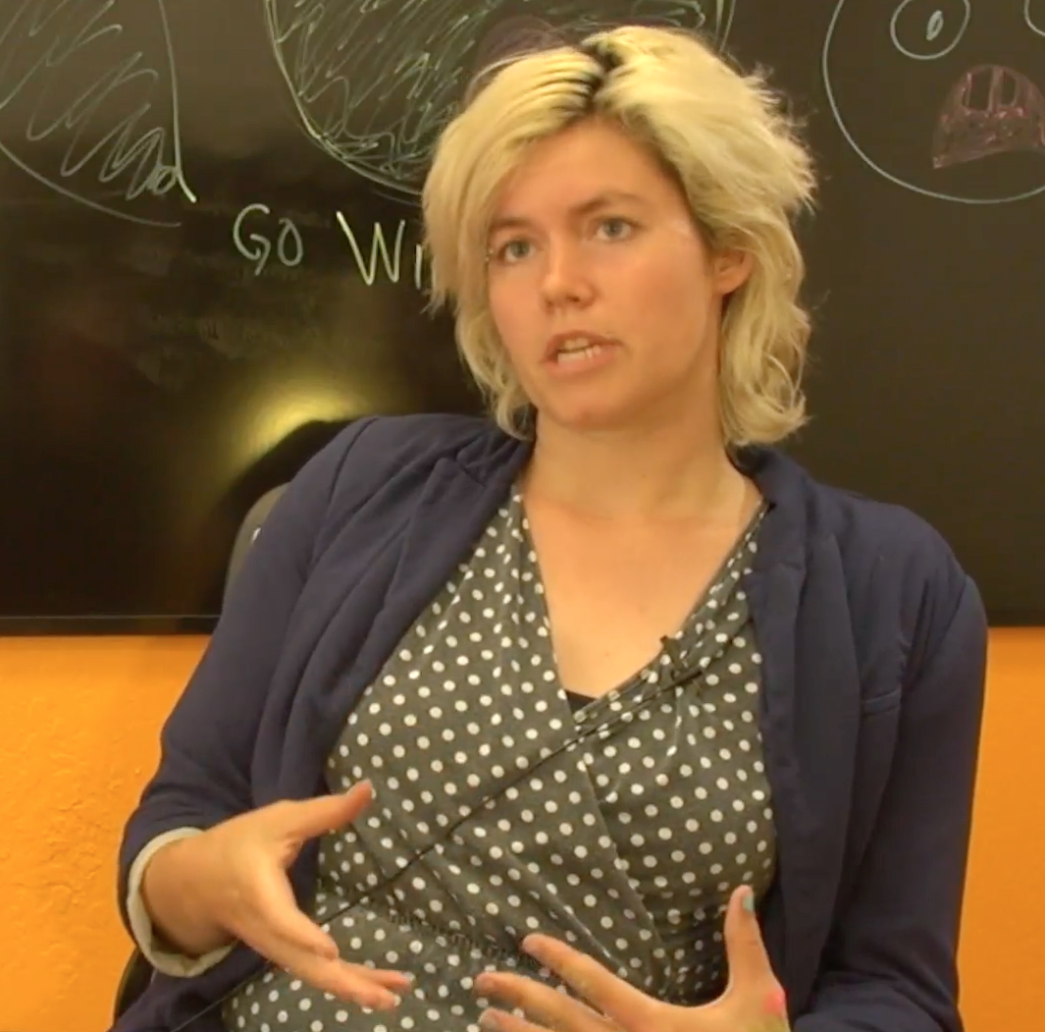
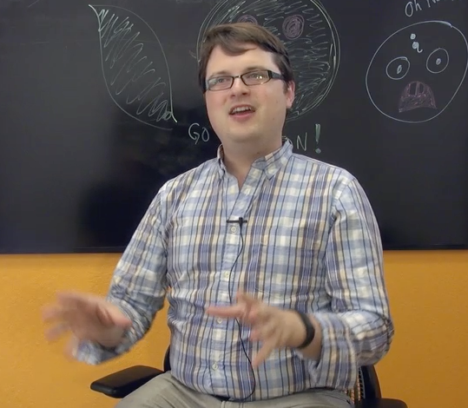
https://www.youtube.com/watch?v=veQaSgjQO2E
Pamela
Fox
John
Resig

Slide 31
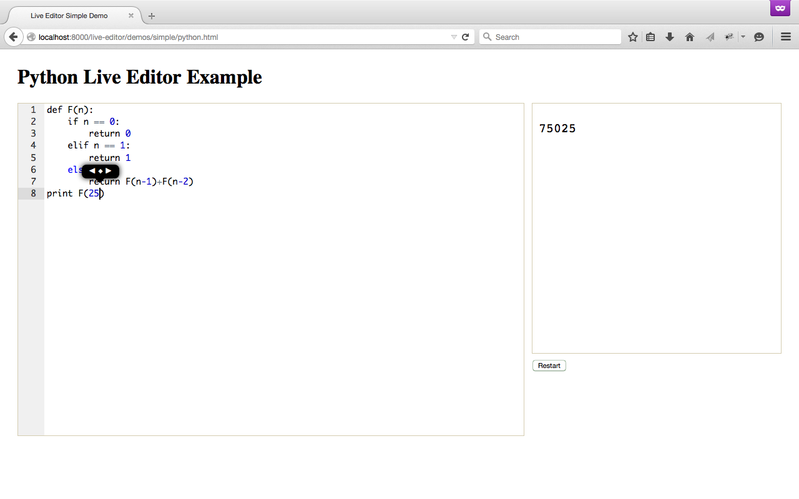
Work In Progress

Slide 32

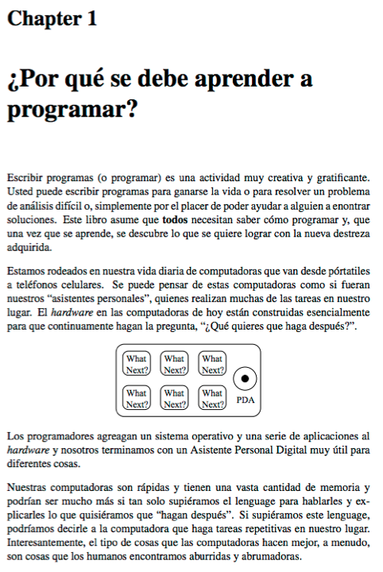
Free Translations
slides.pr4e.org
translate.pr4e.org

Slide 33
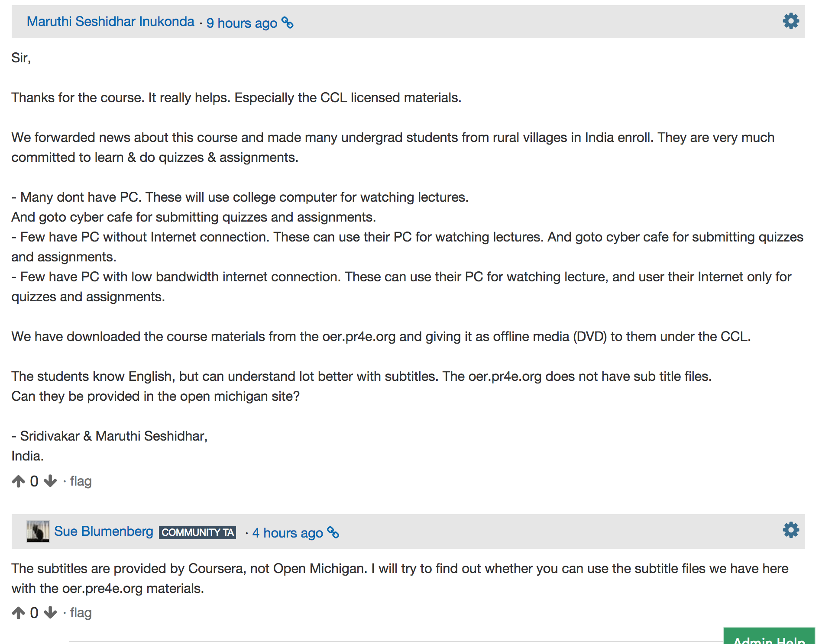

Slide 34
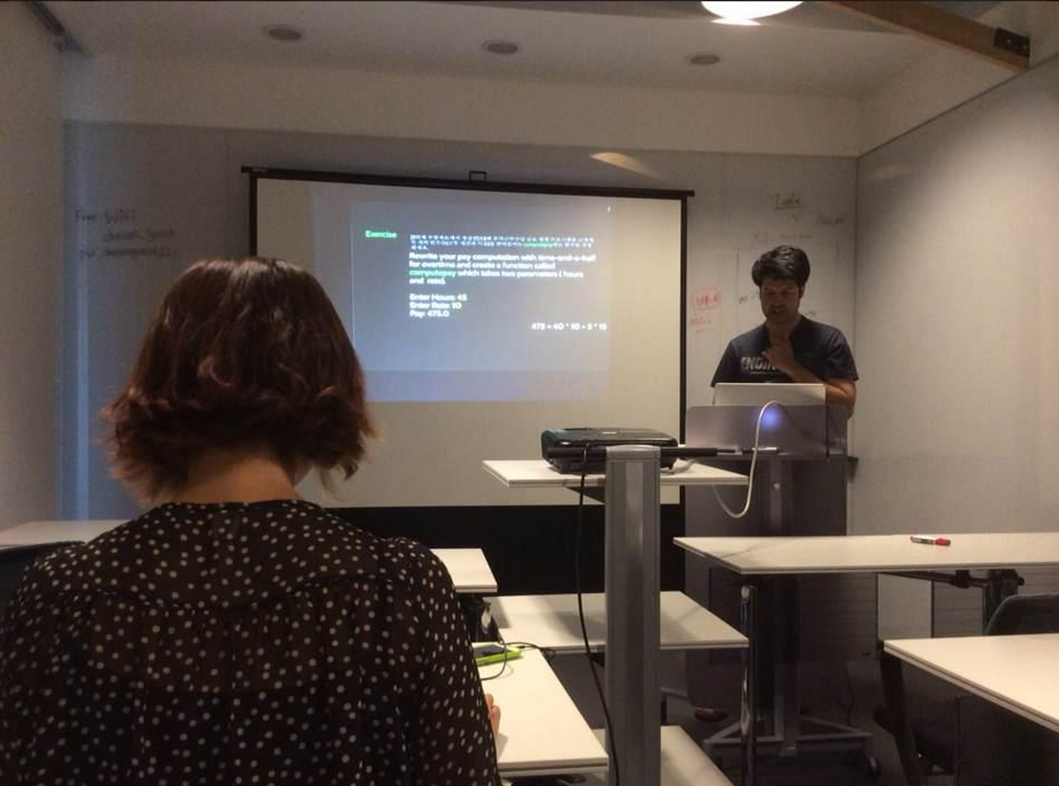
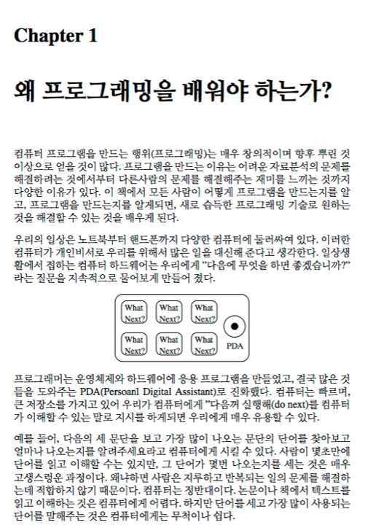
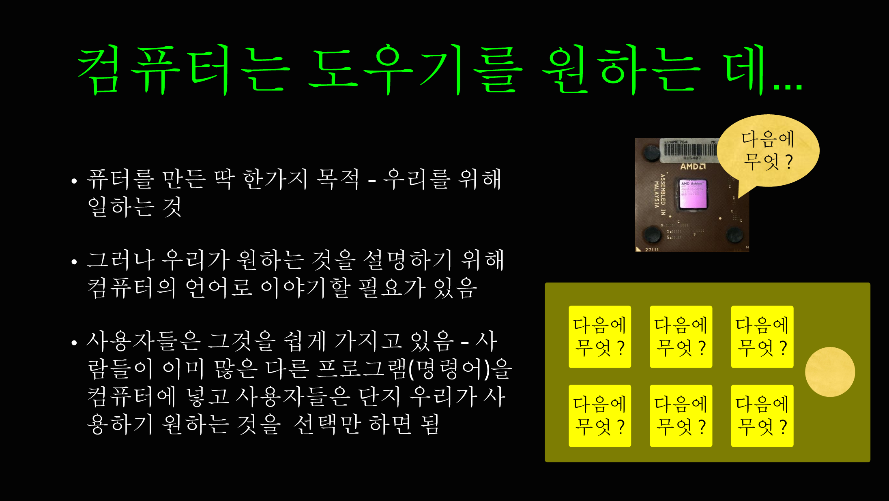


Slide 35
That was one course.

Slide 36
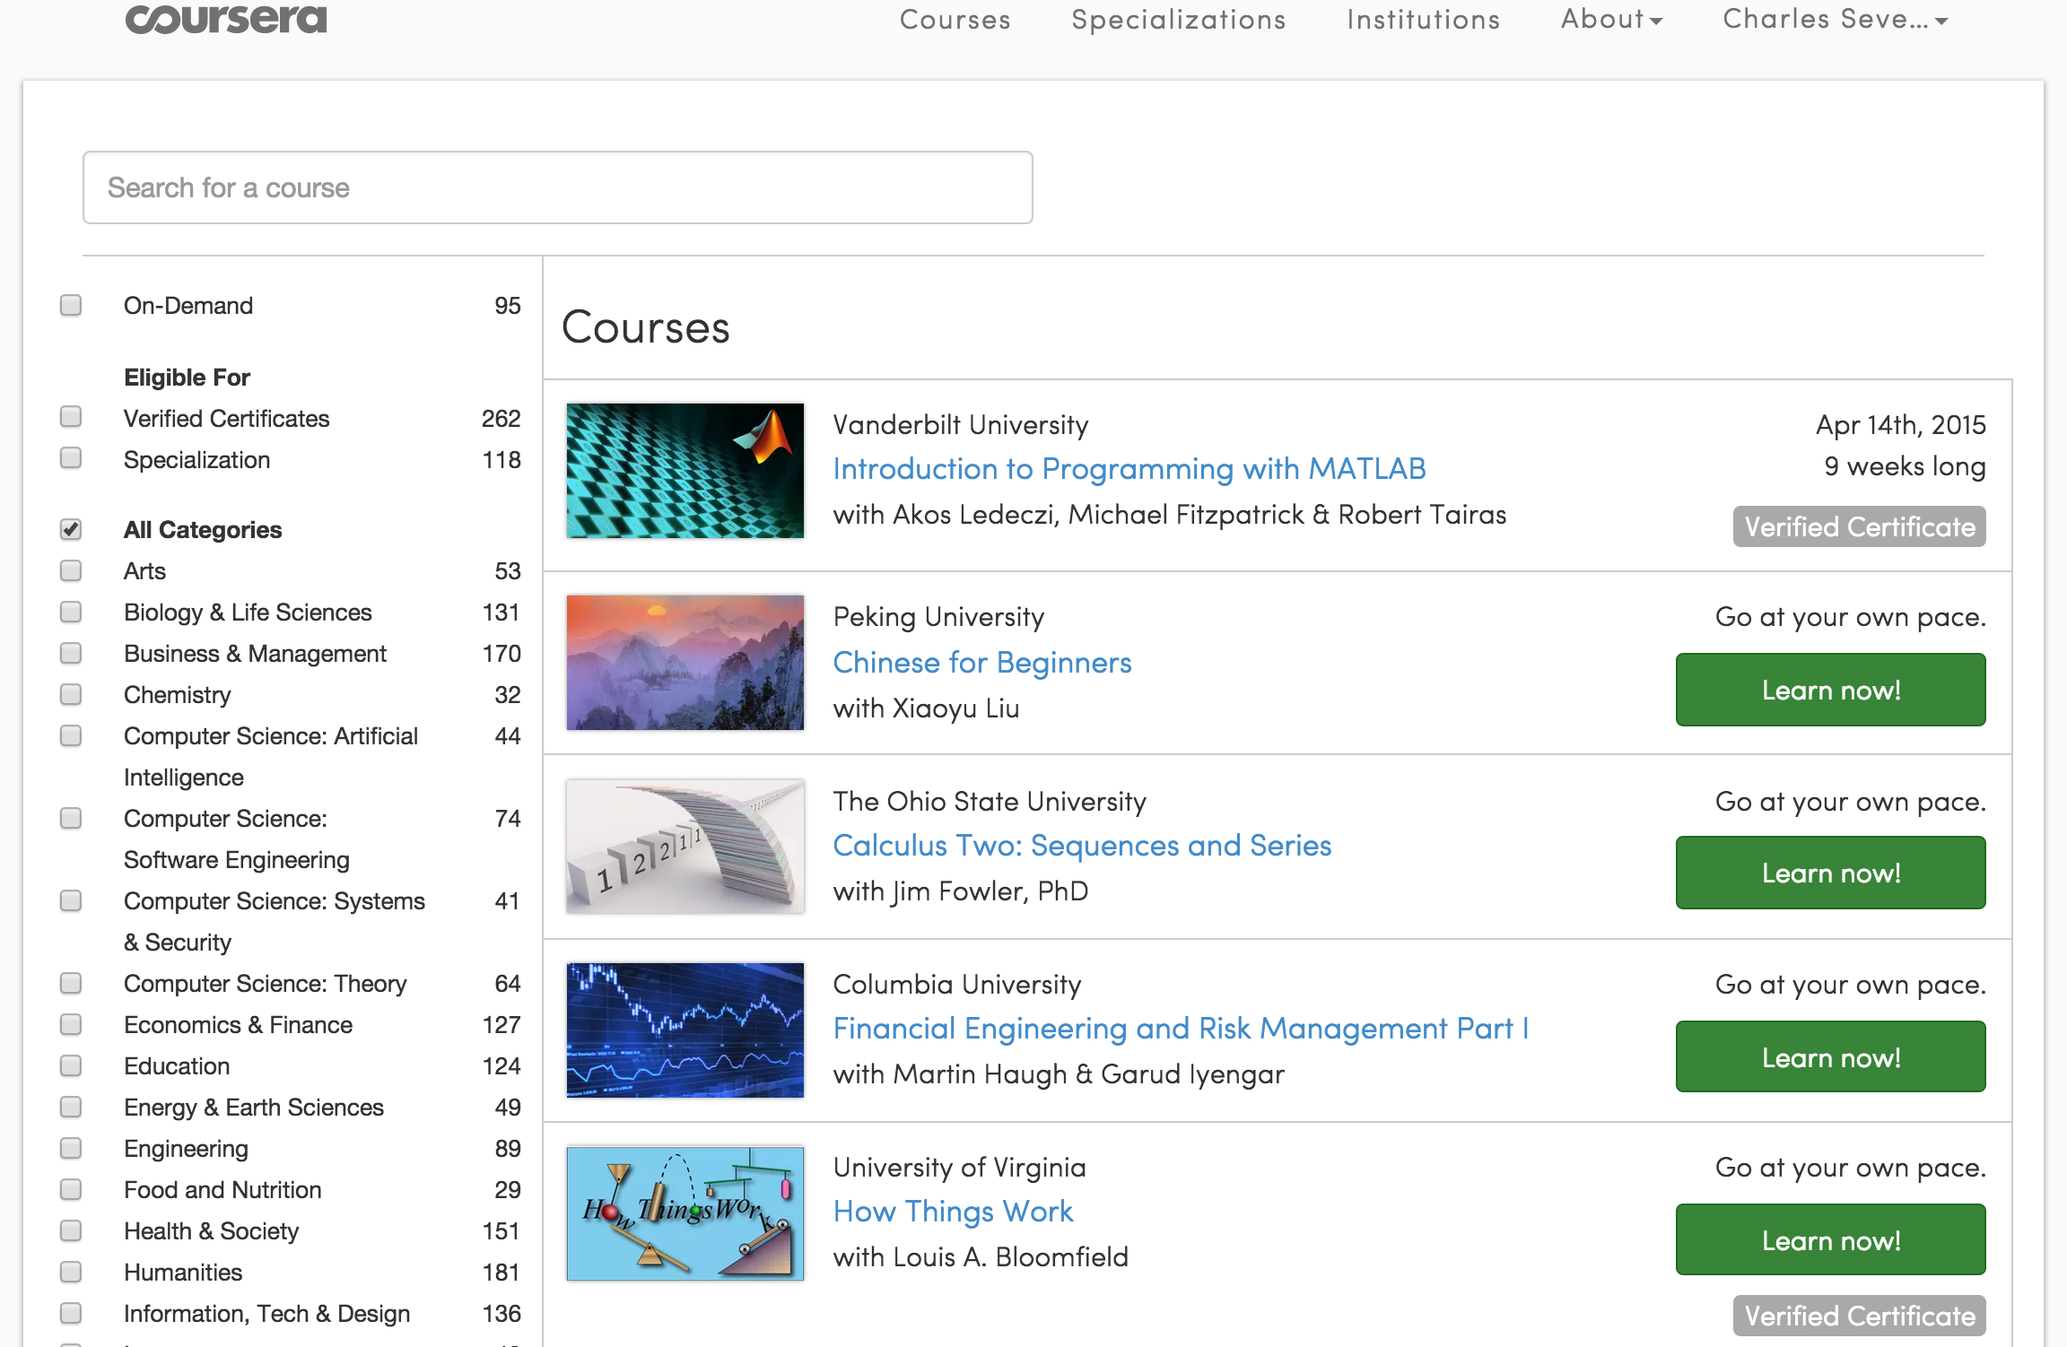
>1000 Coursees
>115 Institutions
>12M Students

Slide 37
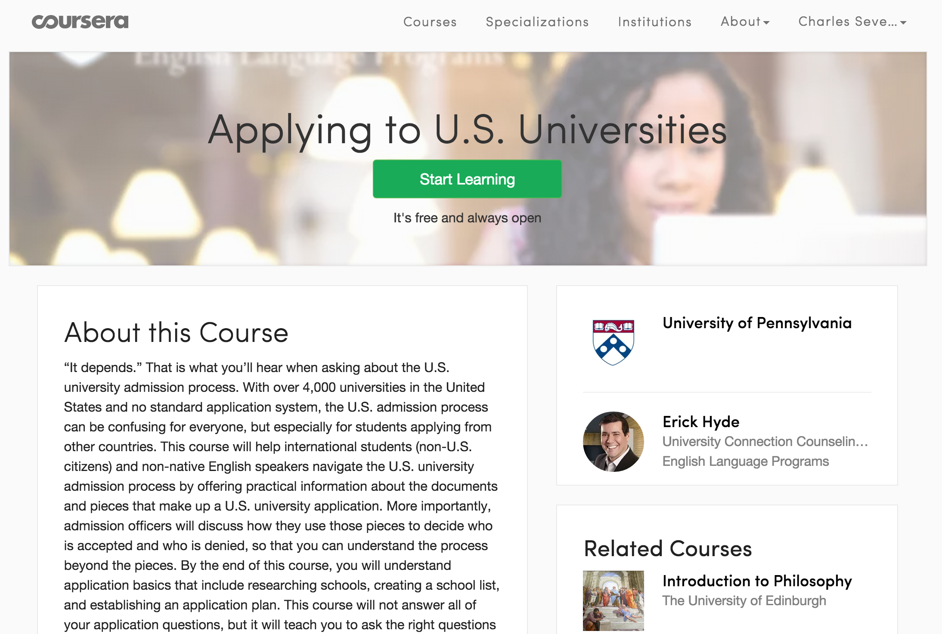

Slide 38
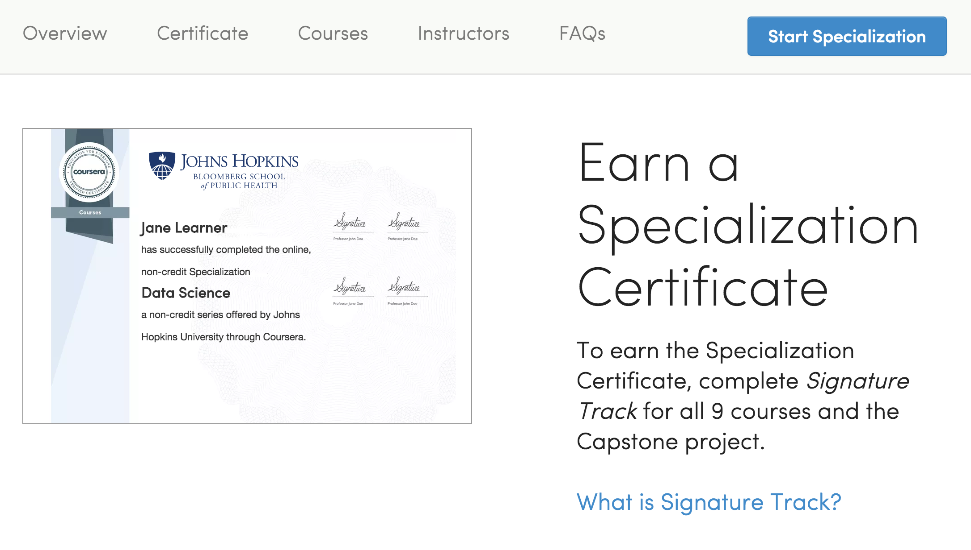

Slide 39
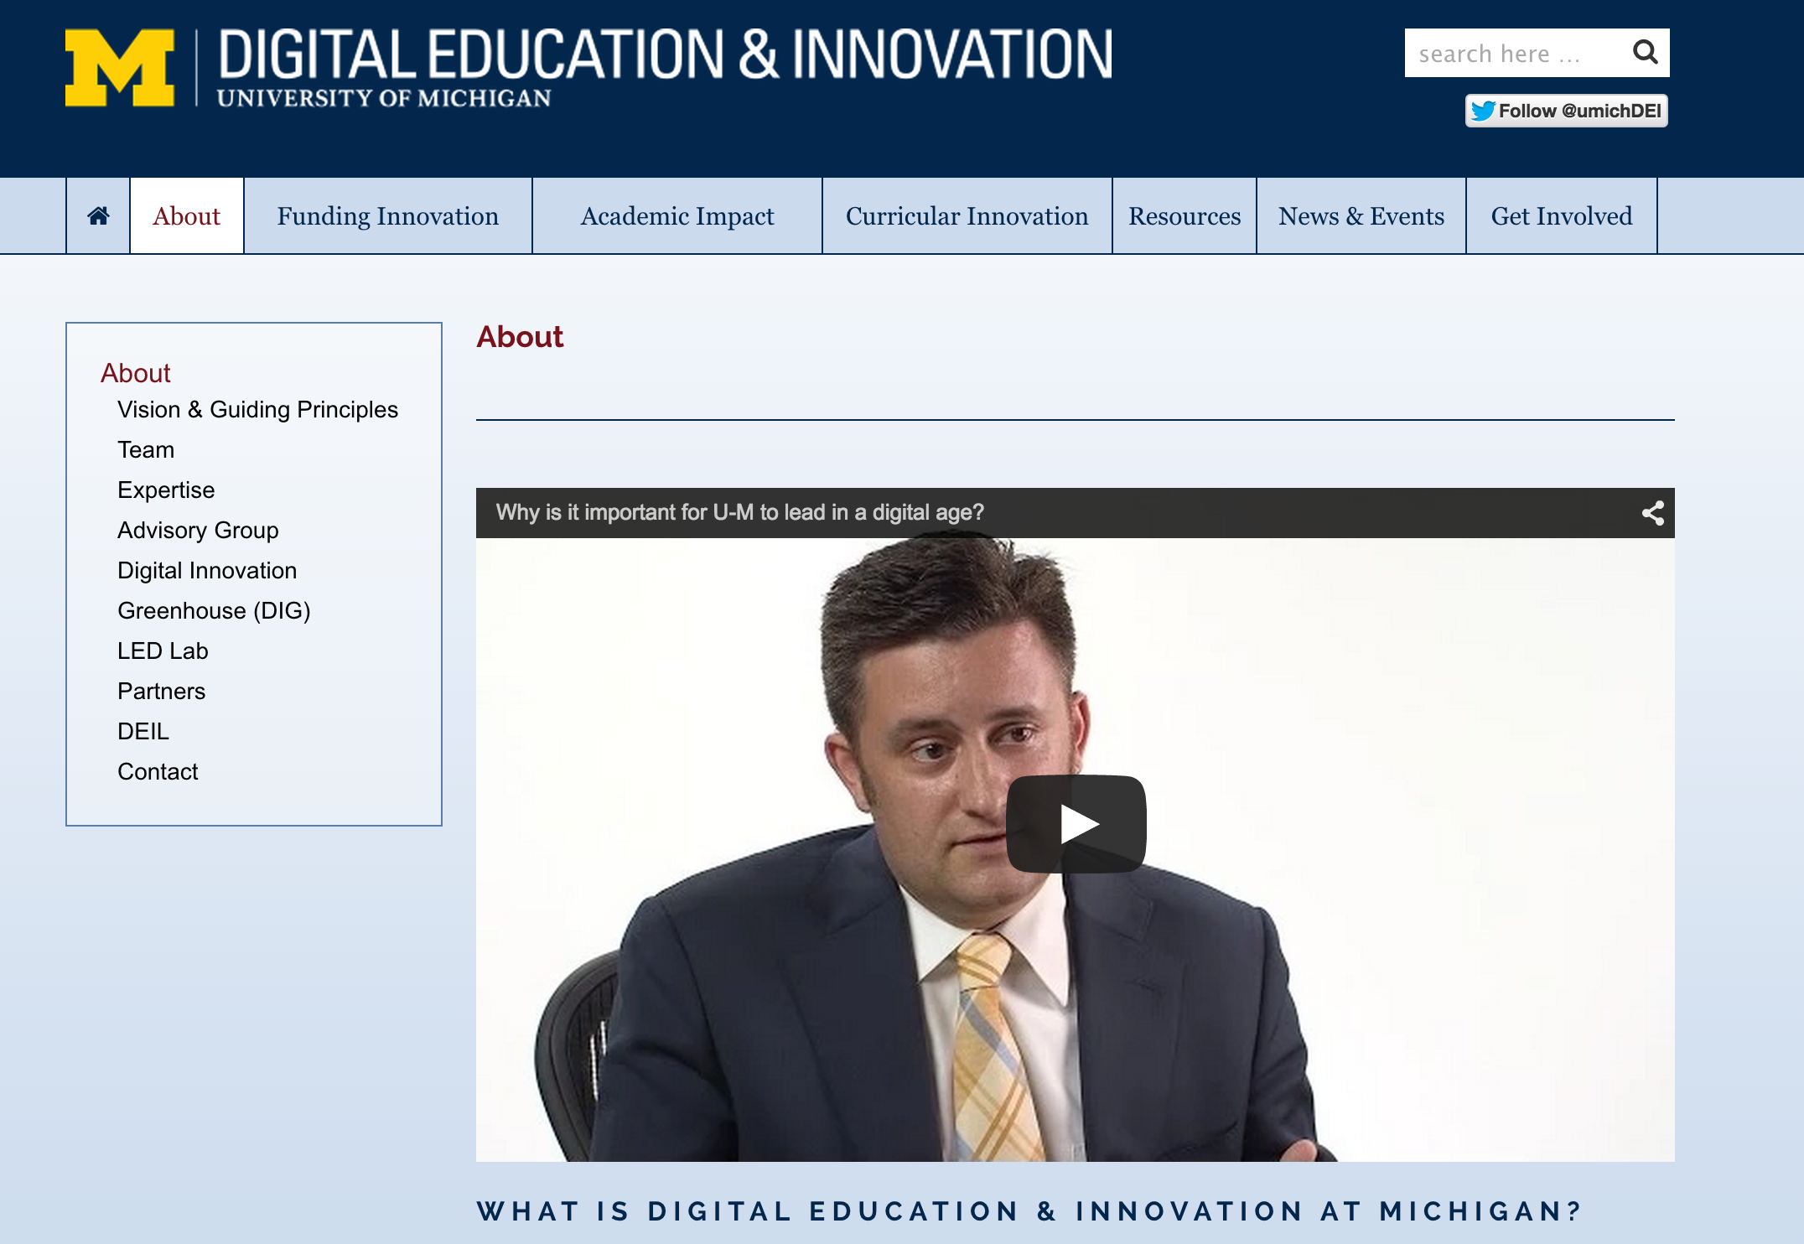
Notes:
It is a responsibility of a public university to lead and define this new space MOOC "Semesters" First week of February, June, and October 30+ courses per year 15 Support Staff Galvanizing education research on campus Learning Analytics Pedagogy

Slide 40
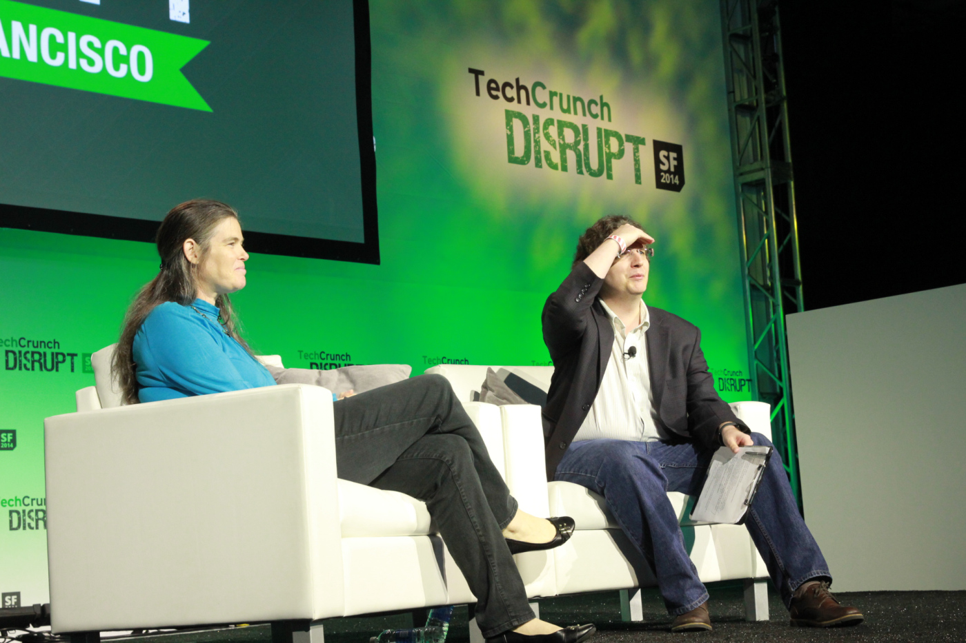


This morning at Disrupt SF, Coursera’s president Daphne Koller pushed back against the notion that her company is a for-profit education company: In her view, Coursera is instead a for-profit technology company.
http://techcrunch.com/2014/09/10/coursera-president-daphne-koller-2014-is-the-year-moocs-will-come-of-age/
Notes:
Market...

